Slide 1

Confusion Matrix
By Aksadur Rahman
aksadur@yahoo.com

Slide 2
Agenda
Confusion Matrix
False/True Positive
False/True Negative
Precision
Recall
F1 Score

Slide 3
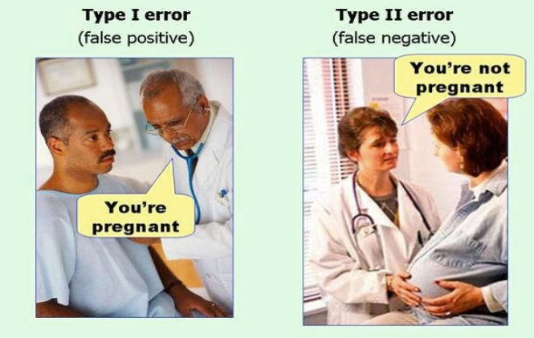
Confusion Matrix

Slide 4
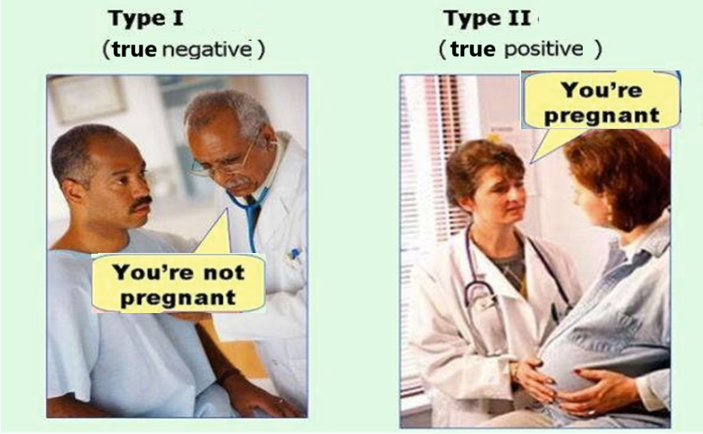
Confusion Matrix

Slide 5
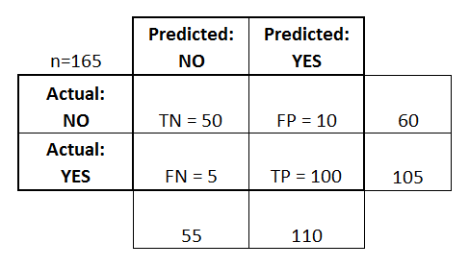
Confusion Matrix in Machine Learning
Confusion Matrix
The confusion matrix is the primary method used to validate a classifier. Most of the model quality and accuracy metrics are based on the values of the confusion matrix. This matrix is a table that contains information about the actual and predicted values for a classifier.
True positives (TP): These are cases in which we predicted yes (they have the disease), and they do have the disease.
True negatives (TN): We predicted no, and they don't have the disease.
False positives (FP): We predicted yes, but they don't actually have the disease. (Also known as a "Type I error.")
False negatives (FN): We predicted no, but they actually do have the disease. (Also known as a "Type II error.")

Slide 6
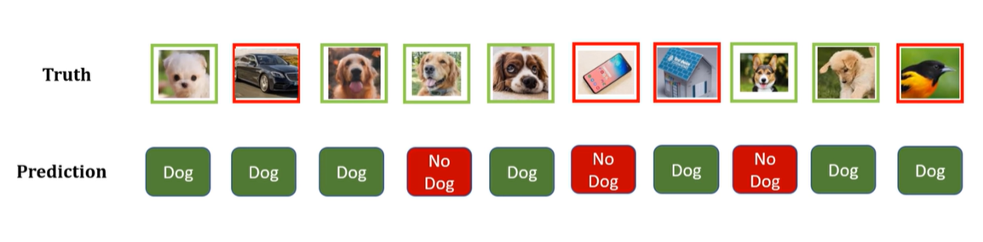
Confusion Matrix in Machine Learning

Slide 7
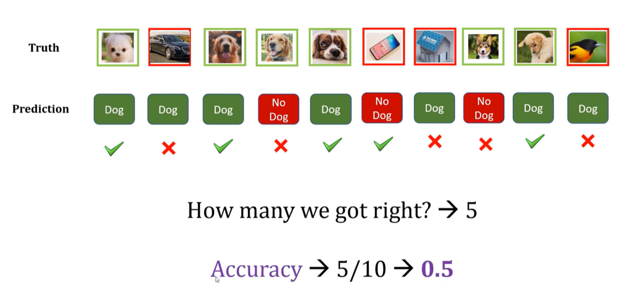
Confusion Matrix in Machine Learning

Slide 8
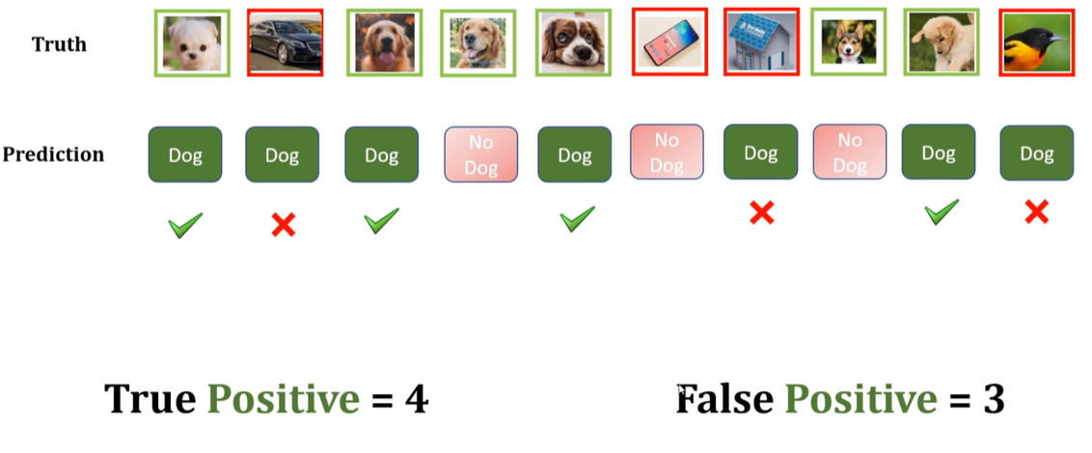
Confusion Matrix in Machine Learning

Slide 9
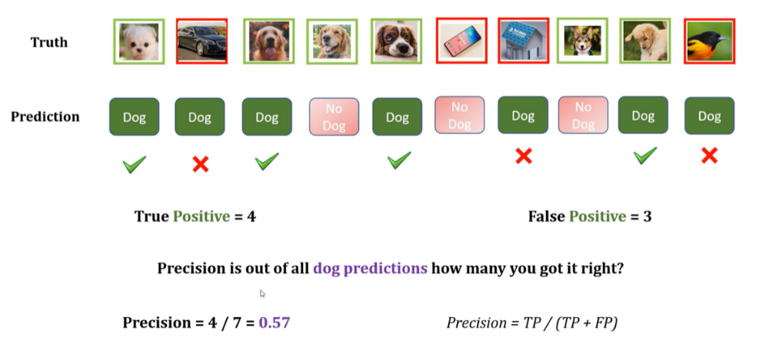
Confusion Matrix in Machine Learning
Precision is a metric that measures how often a machine learning model correctly predicts the positive class. The higher the precision, the better.

Slide 10
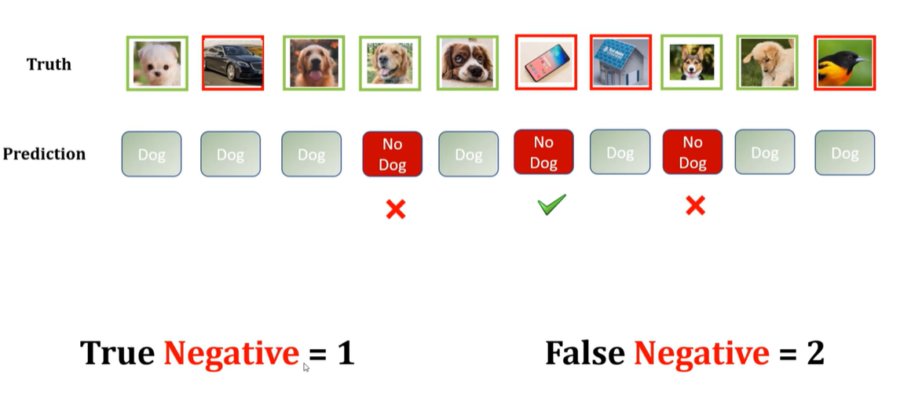
Confusion Matrix in Machine Learning

Slide 11
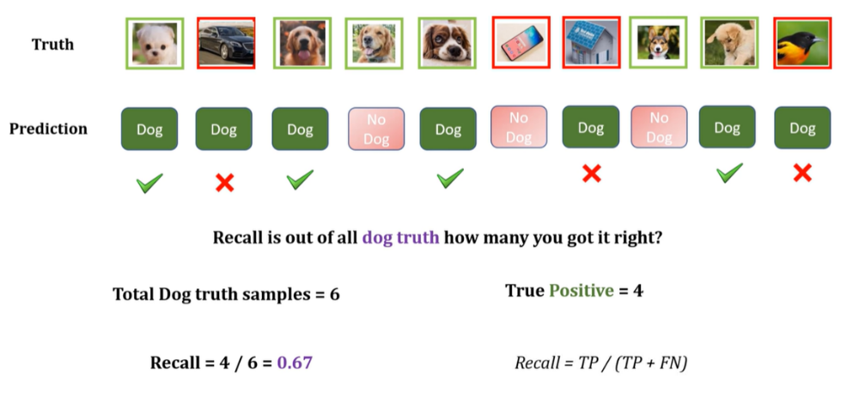
Confusion Matrix in Machine Learning
Recall is a metric that measures how often a machine learning model correctly identifies positive instances (true positives) from all the actual positive samples. The higher the recall, the better.

Slide 12
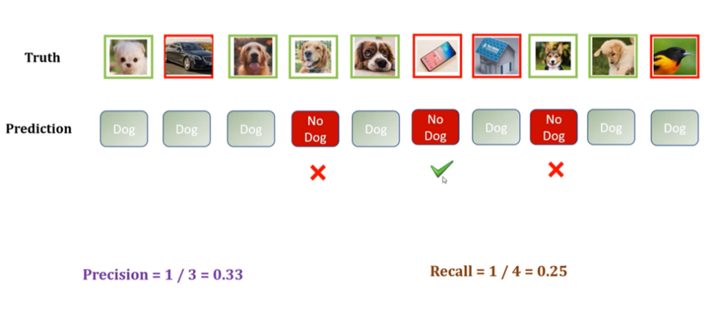
Confusion Matrix in Machine Learning

Slide 13
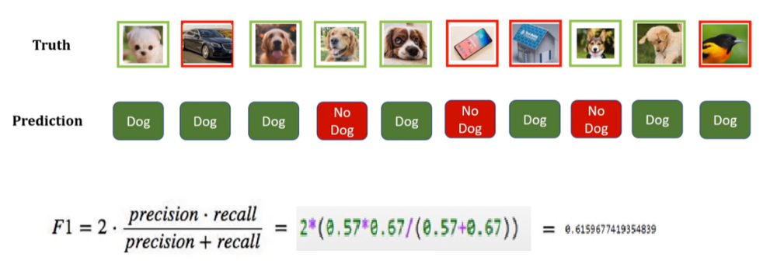
Confusion Matrix in Machine Learning
F1 score : Harmonic mean of Precision and Recall

